Slide 1
ACEI-HACKATHON 5.0

Slide 2
Queue-Easy

Slide 3
Problem Statement
Planning postings for doctors and sisters in the outpatient department is a recurrent challenge due to uneven distribution of patients during different days of week and even different hours of the day especially on high volume days. This leads to long waiting time for the patients.

Slide 4
Our Aim
Our aim is to use machine learning to solve this problem by coming up with a system that updates waiting time for patients and displays it on the website real-time, based on the arrival of patients in the hospital.
This will help the patient make an informed decision regarding his hospital visit.
This will also help automate the mobilization of doctors to clinics with comparatively high volume.

Slide 5
Data used
Predicted and actual patients data for 1.5 years.
5 year data of total number of patients.
1 year data with monthly,weekly and day to day total patient load.
Day wise analysis of 1-month data.
Arrival pattern for patients for a week.
1 week data analysing duration between different stations like Registration, Clinic in-time, Refraction, Investigation and Doctor examination.

Slide 6
Variation between different months in a year
Month | No. of patients
January | 14361
February | 17467
March | 18785
April | 17942
May | 20600
June | 18809
July | 18790
Auguat | 16738
September | 17263
October | 16780
November | 14371
December | 15585

Slide 7
Variation between different months in a year

Slide 8
Variation on different days in a week
 | Percentage of OP for each day in a week in Unit 3
Monday | 17
Tuesday | 15
Wednesday | 14
Thursday | 14
Friday | 17
Saturday | 24

Slide 9
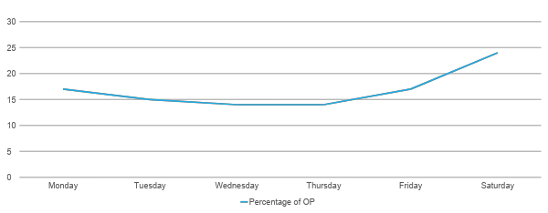
Variation on different days in a week

Slide 10
Variation during different hours in a day
 | Percentage of OP for each hour of a day
7 AM – 8 AM | 8
8 AM – 9 AM | 10
9 AM – 10 AM | 11
10 AM – 11 AM | 15
11 AM – 12 PM | 17
12 PM – 1 PM | 13
1 PM – 2 PM | 8
2 PM – 3 PM | 6
3 PM – 4 PM | 7
4 PM – 5 PM | 3
5 PM – 6 PM | 1

Slide 11
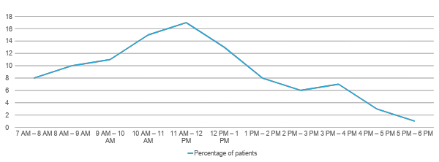
Variation during different hours in a day

Slide 12
Team of doctors available
Senior MO
Junior MO,
Fellow
POSTGRADUATES

Slide 13
Our proposed solution
Creating an ML model to predict average waiting time which can be displayed at the reception display which can also be integrated with the existing systems in order to recommend less hectic time to the patients.
Allocating less work loaded doctors to a crowded section of the hospital based on the skills he/she has which could ease the flow of work.

Slide 14
Predicting the Average wait time
🡪Telling the average waiting time to the patients helps them plan their next visit during the less hectic period of the day or less hectic day of the month 🡪helps to organize and distribute the cases uniformly over all the days,reducing the chaos during the peak hours

Slide 15
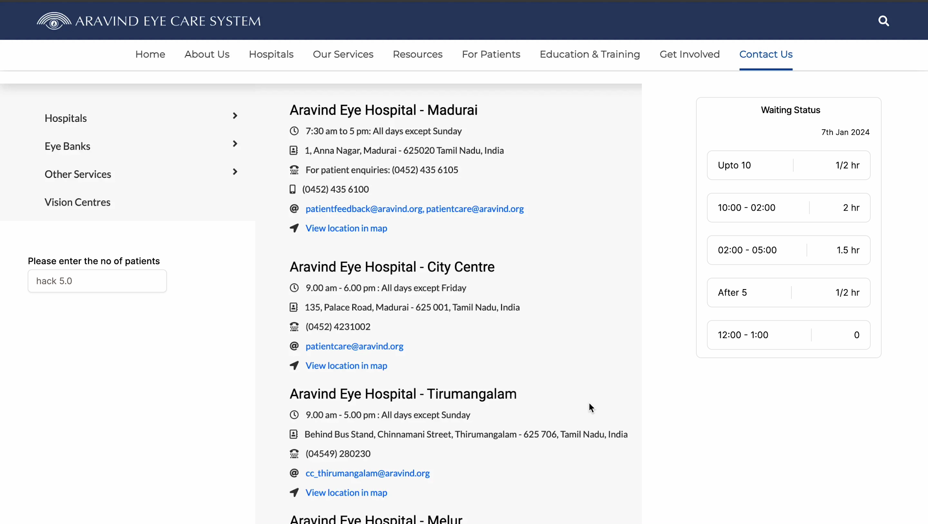
Demo video

Slide 16
About the arima model

Slide 17
Recommending allocation of doctors to the overloaded sections of the hospital based on their matching skill
Data used to create the model
🡪Doctors speciality : skills & speciality,experience level & seniority
🡪Emergency or routine cases : allocate senior or junior doctors respectively

Slide 18
Model creation snippet

Slide 19
Breaking down the model
🡪using tensorflow/keras models
🡪training and testing the model based on the parameters
🡪testing and tuning the weights and parameters
🡪displaying the recommended section of the hospital

Slide 20
Basic frontend snippet

Slide 21
Future Enhancements
🡪predicting excess footfall in the hospital by detecting nearby unlikely event
🡪Train and test more thoroughly by applying separate models such as the numerical model

